Slide 1

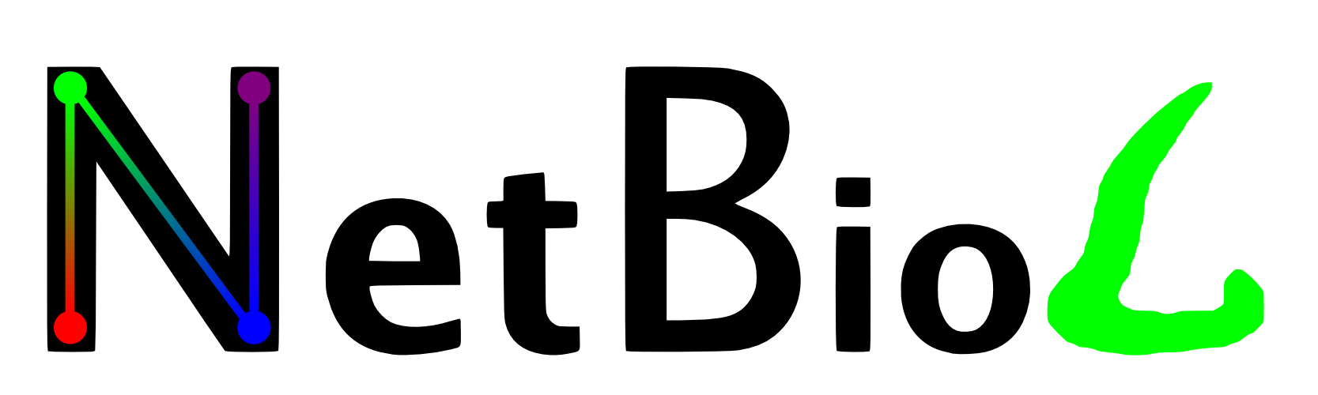
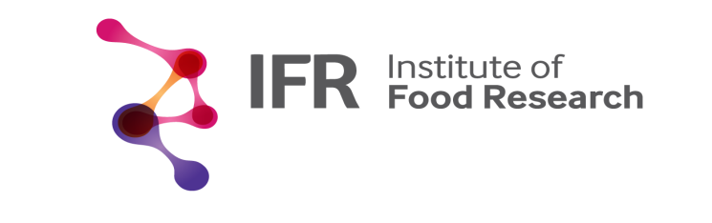
Cellular signalling networks
Tamás Korcsmáros
Network Biology Group
http://netbiol.elte.hu

Slide 2
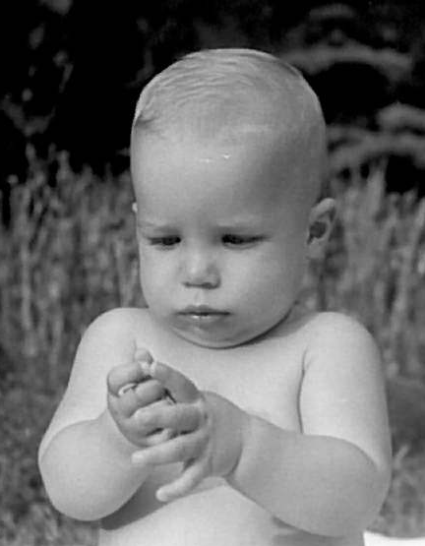
Early research career
Started as a high-school research student
4 years at a medical biochemistry lab
MSc in biochemistry and molecular biology
PhD on metazoan signalling networks

Slide 3
Previous research interests and results
Signalling networks (cross-talks, multi-pathway proteins and their regulations)
Cancer-related networks (systems-level changes)
Network-related drug discovery and design (propose novel targets and summarize concepts)
NRF2-ome (interactome and regulome of a master antioxidant transcription factor)
Autophagy regulation (novel regulators)
Research + Service

Slide 4
Current research interests
Regulation of autophagy by intracellular bacterial species in the gut
Reconstruction of a Salmonella molecular network
Develop workflows to analyze host-pathogen interactions
In silico + In vitro

Slide 5



Slide 6
Thematics
Signalling cross-talks and visualization challenges
Theoretical introduction and visualization ideas
Case study I. – SignaLink database
Practical session with UniProt, protein identifiers and ID mapping
Extending pathways – from pathways to networks
Regulation possibilities of the signalling flow
Case study II. – NRF2 interactome & regulome
Practical session on gene expression data integration

Slide 7
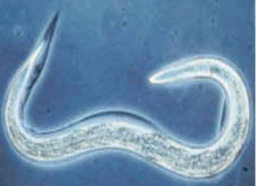

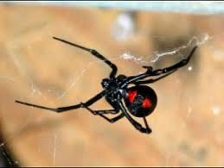

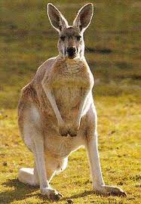

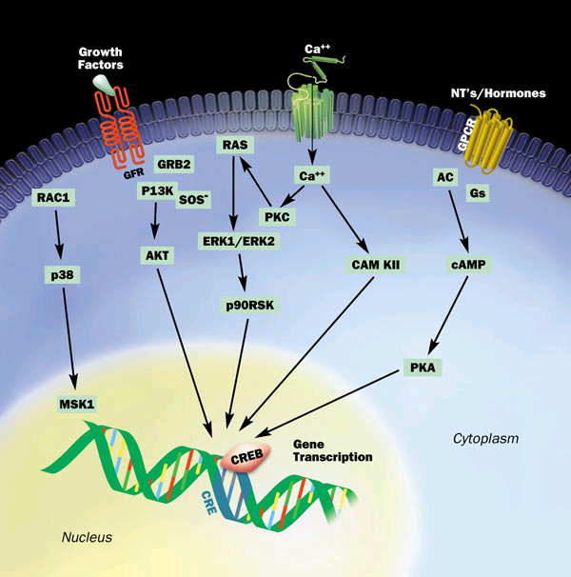
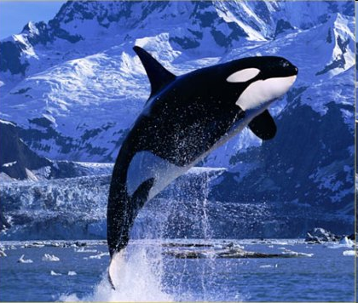
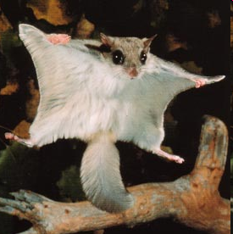
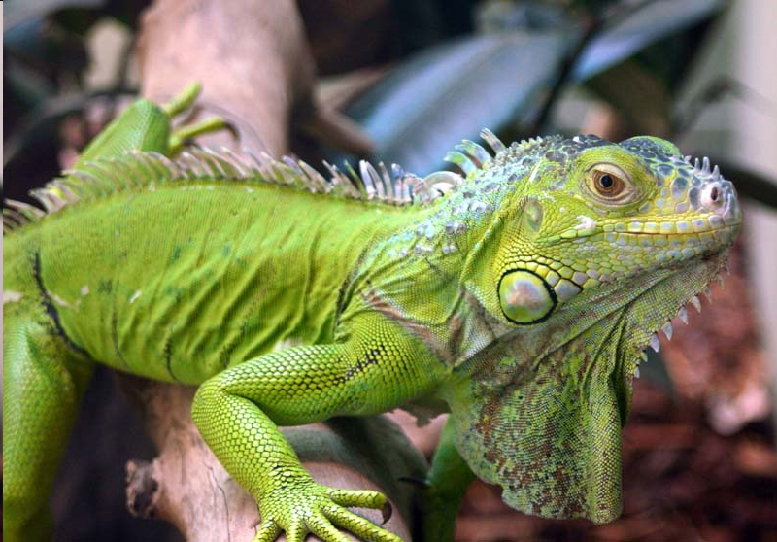
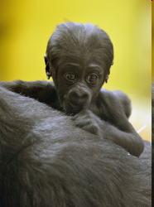

Signalling pathways
Contradictions
Many cell types and phenotypes
But relatively low number of signalling proteins
Relatively low number of signalling pathways

Slide 8
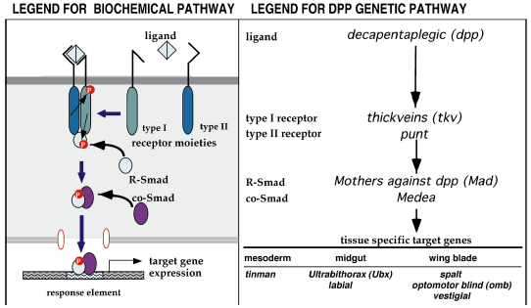
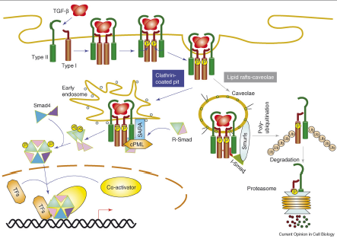
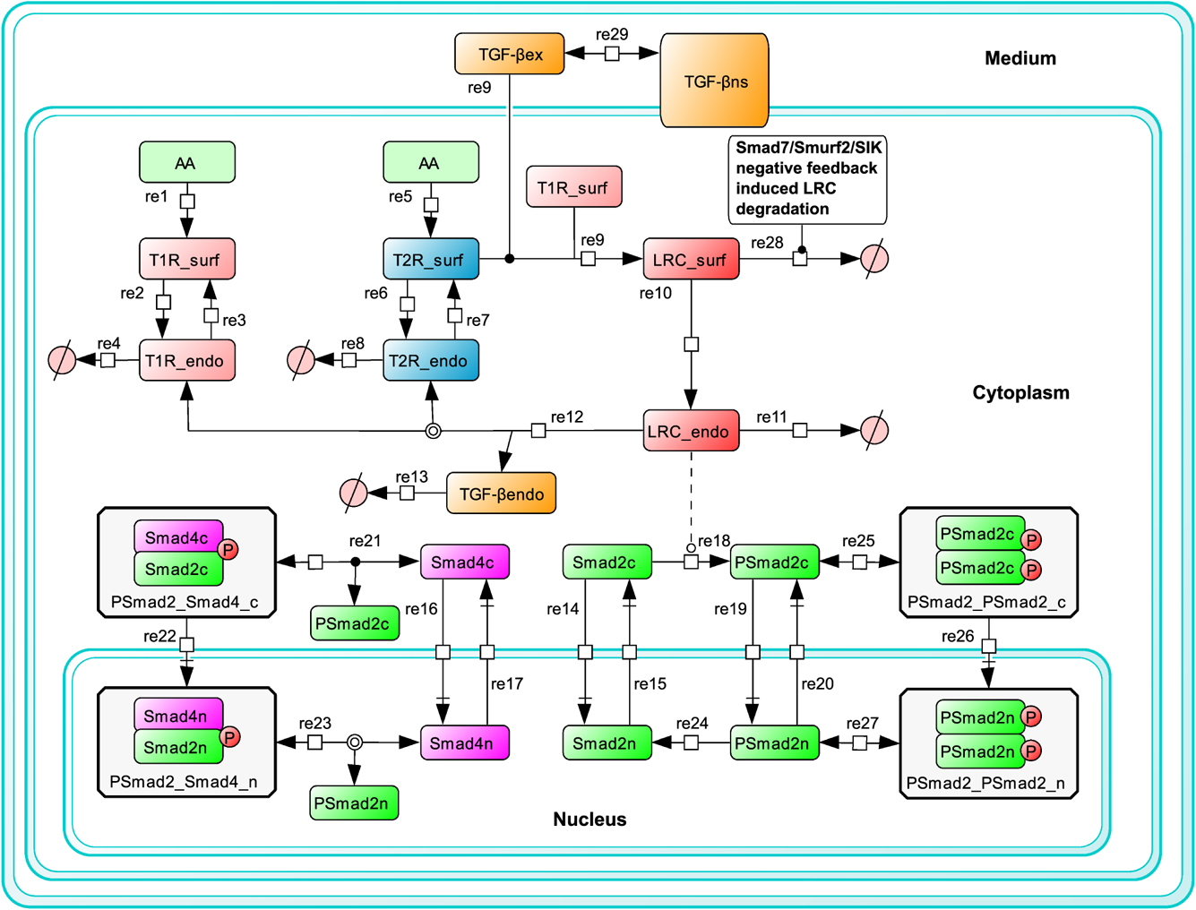
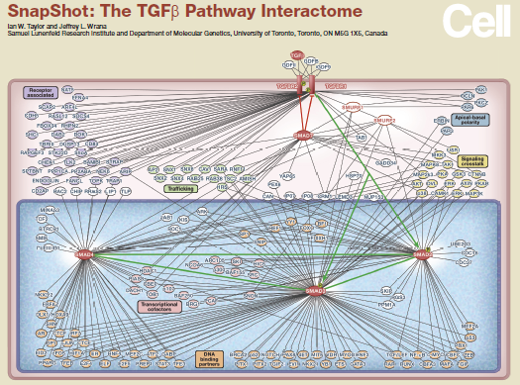
Research approaches
Biochemistry
Genetics
Cell biology
Bioinformatics
Network biology

Slide 9
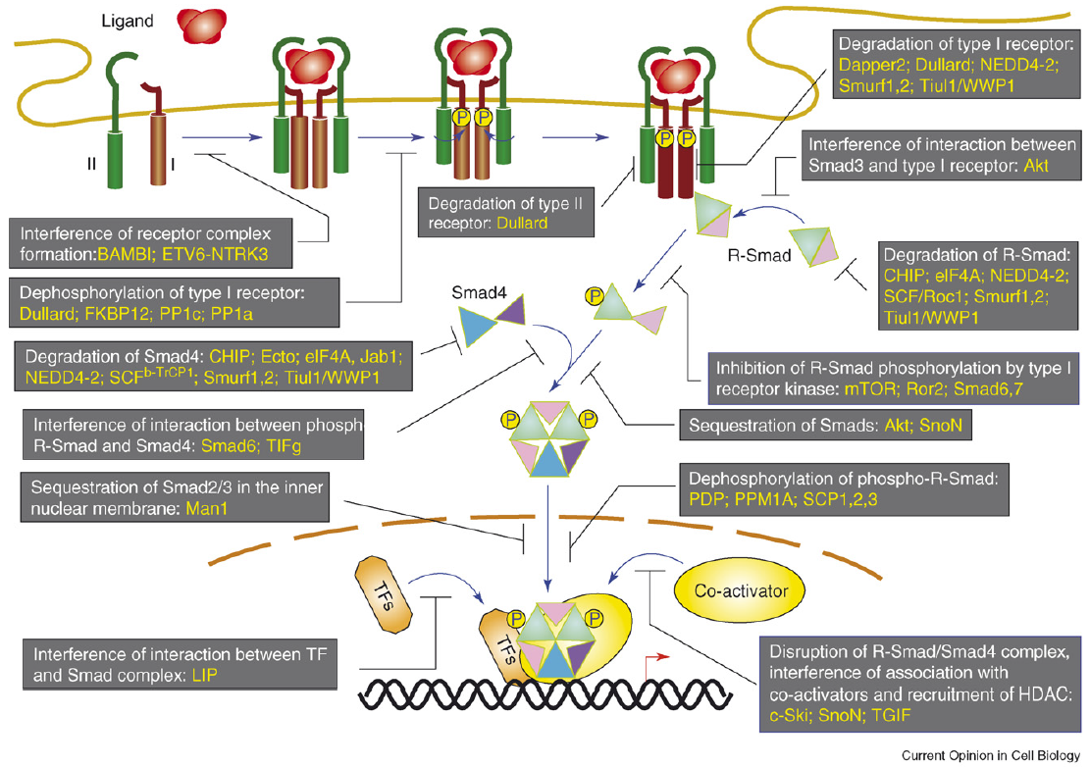
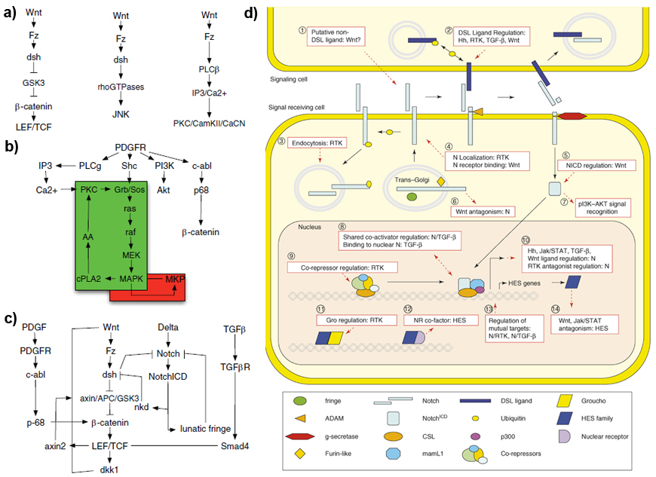
Cross-talks between pathways
Curr Opin Cell Biol, 19. 166–175 (2007); Curr Opin Cell Biol, 19. 176–184 (2007)

Slide 10
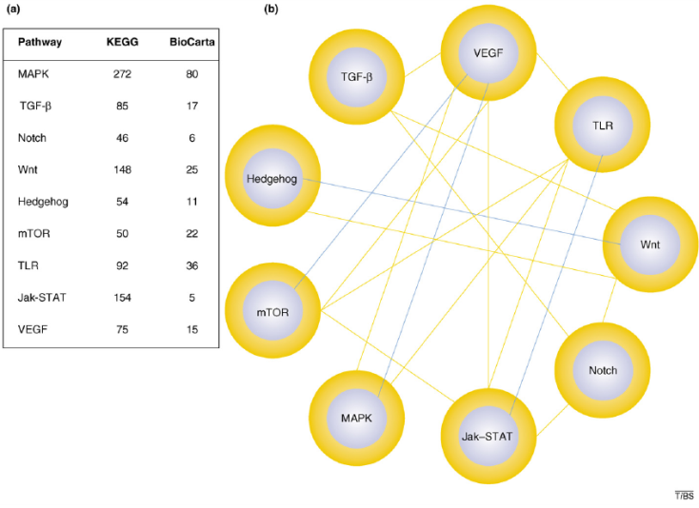
Overlaps between pathways
Lu et al., Trends Biochem Sci, 32: 320–331 (2007)

Slide 11
Signalling pathways and networks
Pathway definitions are not identical
Curation rules are not uniform
Not enough and identical details / sources
Cross-talks and overlaps (multi-pathway proteins) cannot be examined (easily)
Problems and challenges in signalling pathway databases
Input Ligands
Pathway mediators (cross-talk proteins)
Output Transcription factors

Slide 12
Types of signalling pathways
Canonical (e.g., MAPK)
Functional (e.g., inflammation)
Inferred (e.g., from gene expression data)
Cellular process regulating (e.g., autophagy induction)
Organ-related (e.g., vulva development)
Disease-related (e.g., list of connected proteins affected by mutations in breast cancer; Alzheimer’s disease, etc.)
Drug-related (e.g., pharmacologically affected list of connected proteins)
Highly overlapping, functionally NOT distinct pathways
↓
Comparison or cross-talk analysis between different types of signalling pathways is incorrect!

Slide 13
Types of signalling pathways
Canonical (e.g., MAPK)
Functional (e.g., inflammation)
Inferred (e.g., from gene expression data)
Cellular process regulating (e.g., autophagy induction)
Organ-related (e.g., vulva development)
Disease-related (e.g., list of connected proteins affected by mutations in breast cancer; Alzheimer’s disease, etc.)
Drug-related (e.g., pharmacologically affected list of connected proteins)
Highly overlapping, functionally NOT distinct pathways
↓
Comparison or cross-talk analysis between different types of signalling pathways is incorrect!

Slide 14
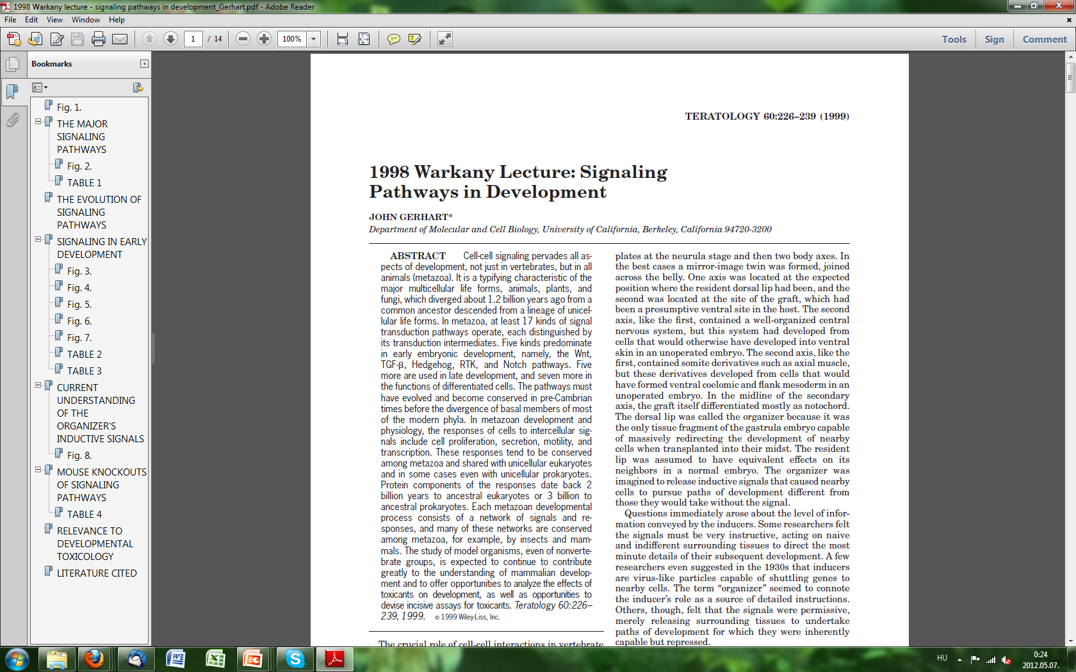
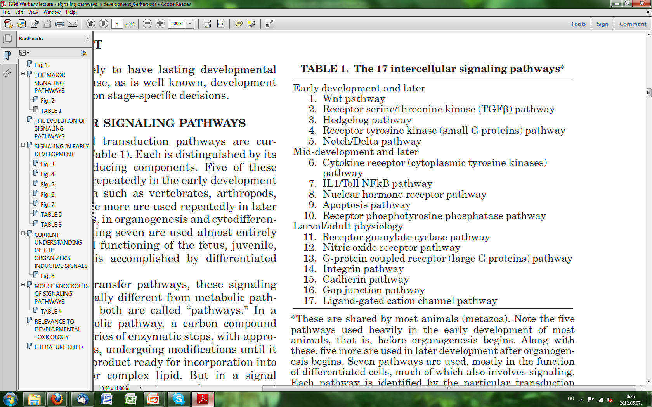
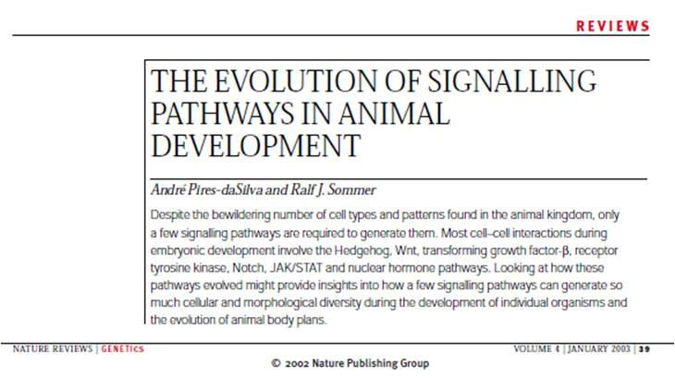
Definition of canonical signalling pathways

Slide 15
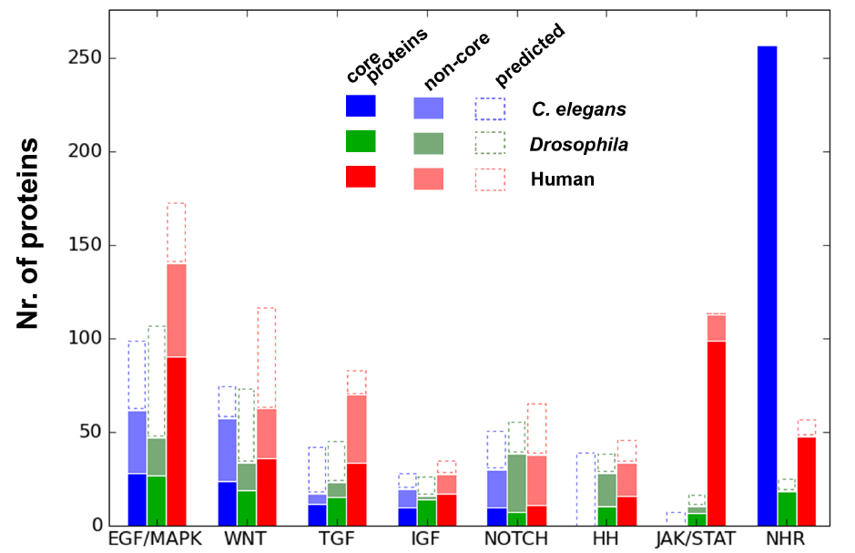
Case study I. - the SignaLink database
http://SignaLink.org
3 metazoans
8 biochemically defined pathways
Manually curated, uniform curation rules
All interactions are directed and link to experimental research articles
Contains multi-pathway proteins and cross-talks
Versions: 2006, 2008, 2012*
Compared to 3 pathway databases
SignaLink contains the highest number of proteins, interactions, cross-talks and literature sources (between the examined pathways)
Allows the system-level examination of the signalling network
Korcsmaros et al., Bioinformatics (2010), PLoS ONE (2011)

Slide 16
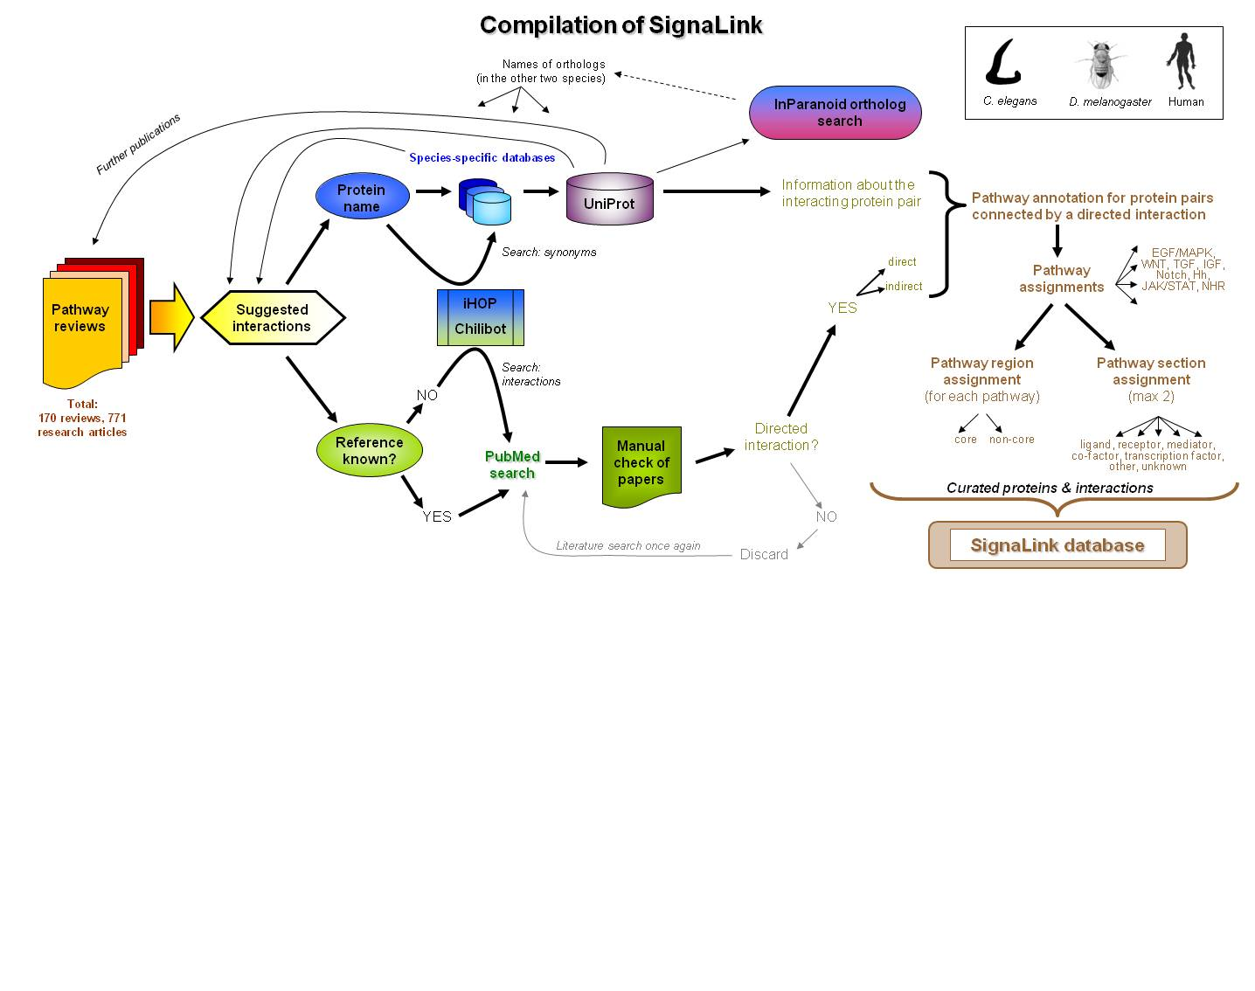
Curation protocol of SignaLink

Slide 17
Network of signalling pathways
How can we visualize cross-talks?

Slide 18
Network of signalling pathways
1) Color-coded protein-protein interaction network
2) Cross-talk network

Slide 19
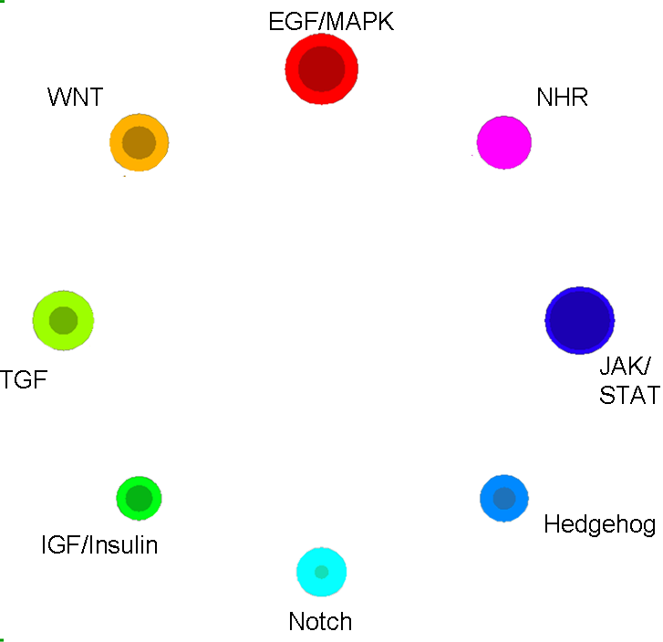
Network of signalling pathways

Slide 20
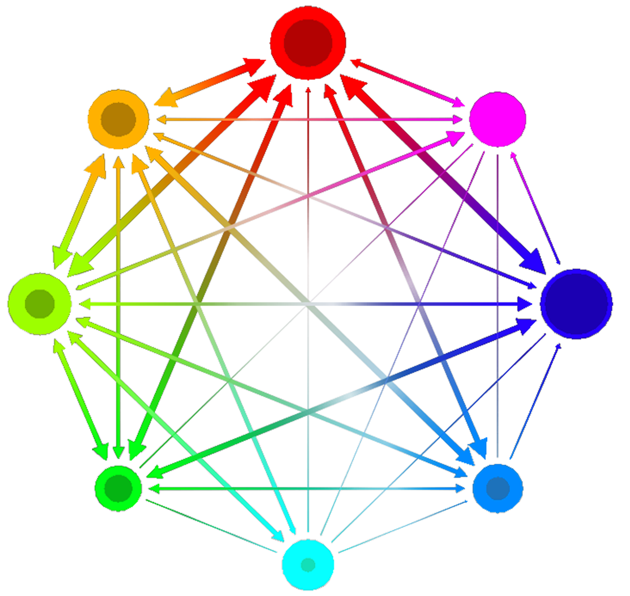
EGF/MAPK
WNT
NHR
JAK/ STAT
TGF
Hedgehog
IGF/Insulin
Notch

Slide 21
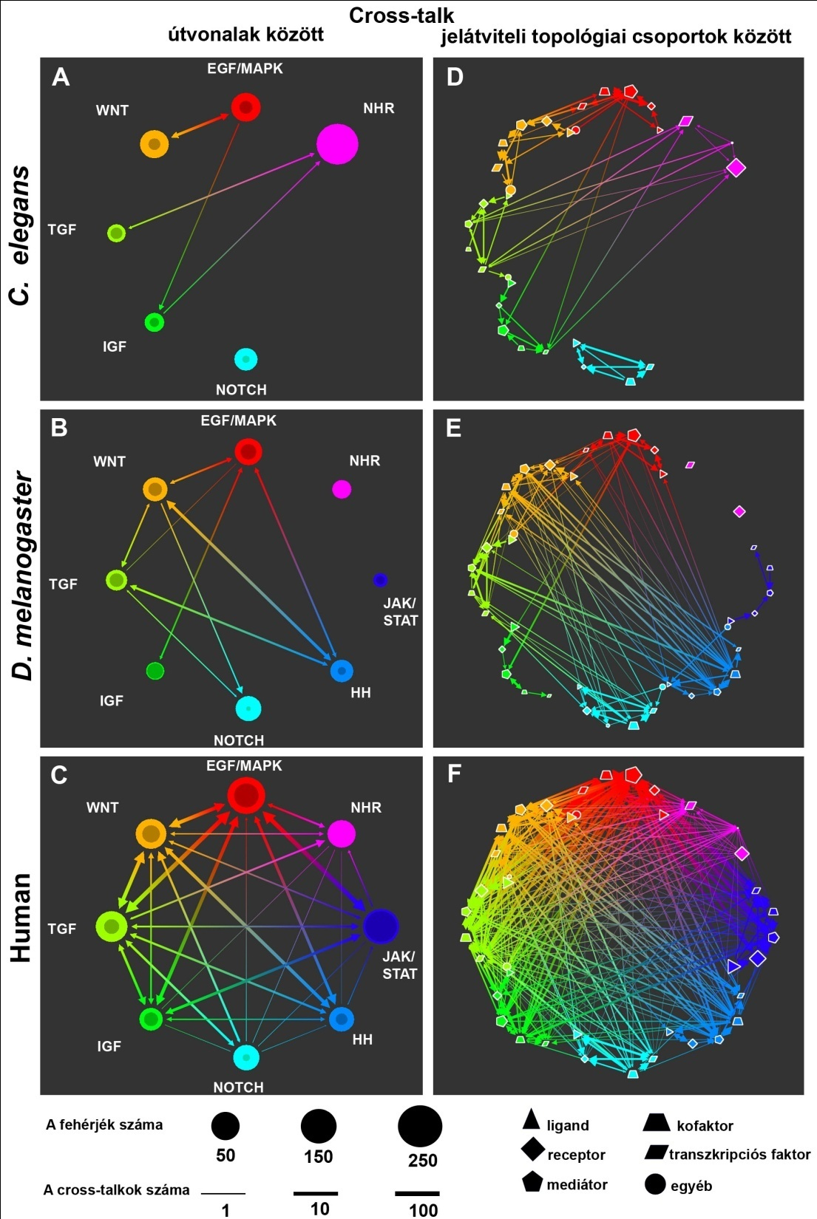

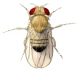
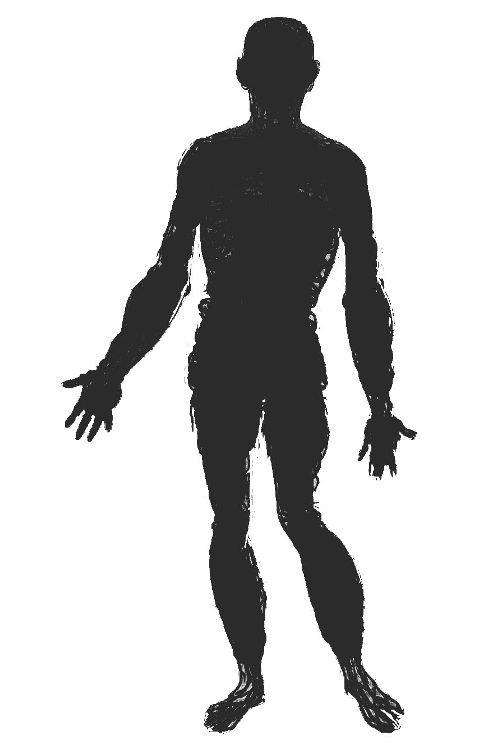
Cross-talk networks in 3 metazoans
NHR
Nr. of proteins
Nr. of cross-talks
Korcsmaros et al., Bioinformatics (2010)

Slide 22
Detailed cross-talk networks in 3 metazoans
ligand
co-factor
receptor
transcription factor
mediator
other
Korcsmaros et al., Bioinformatics (2010)

Slide 23
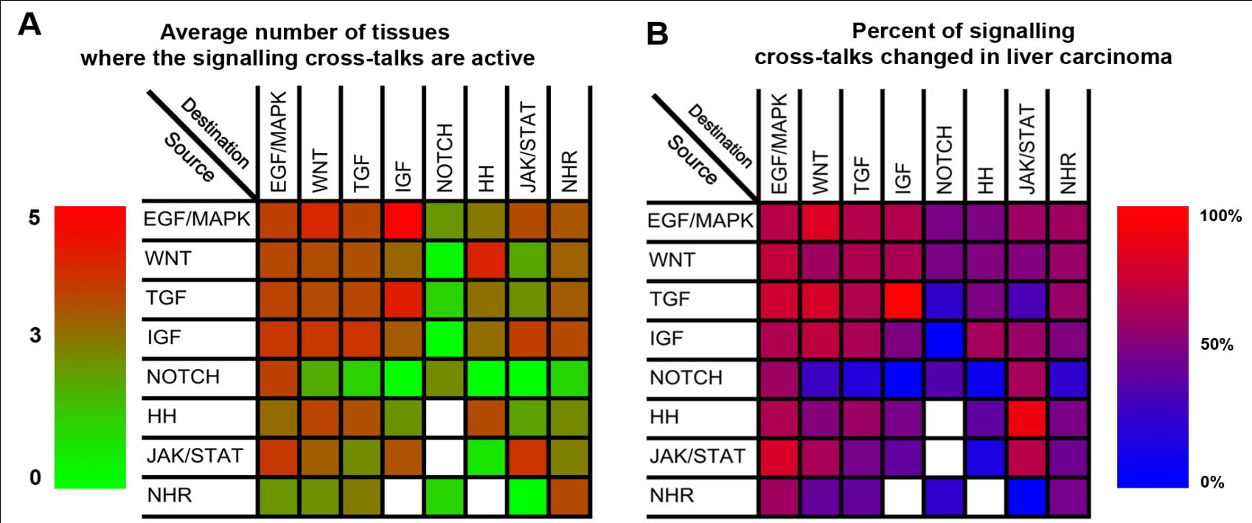
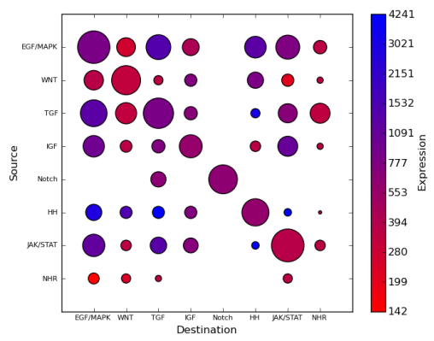
Visualizing cross-talk expressions
Identification of tissue-, disease-, and cell-type specific cross-talks
Korcsmaros et al., Bioinformatics (2010)

Slide 24
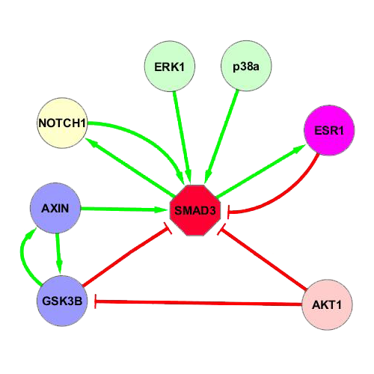
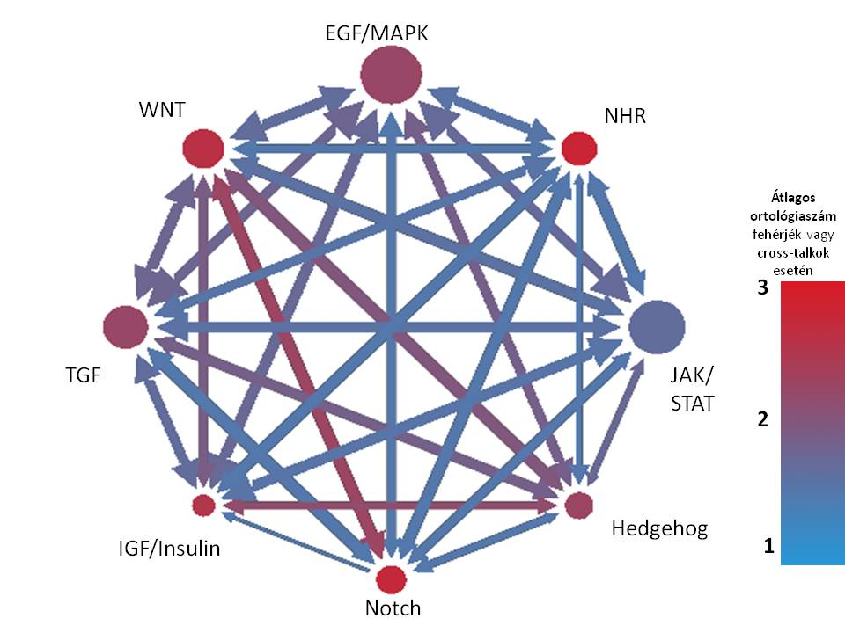
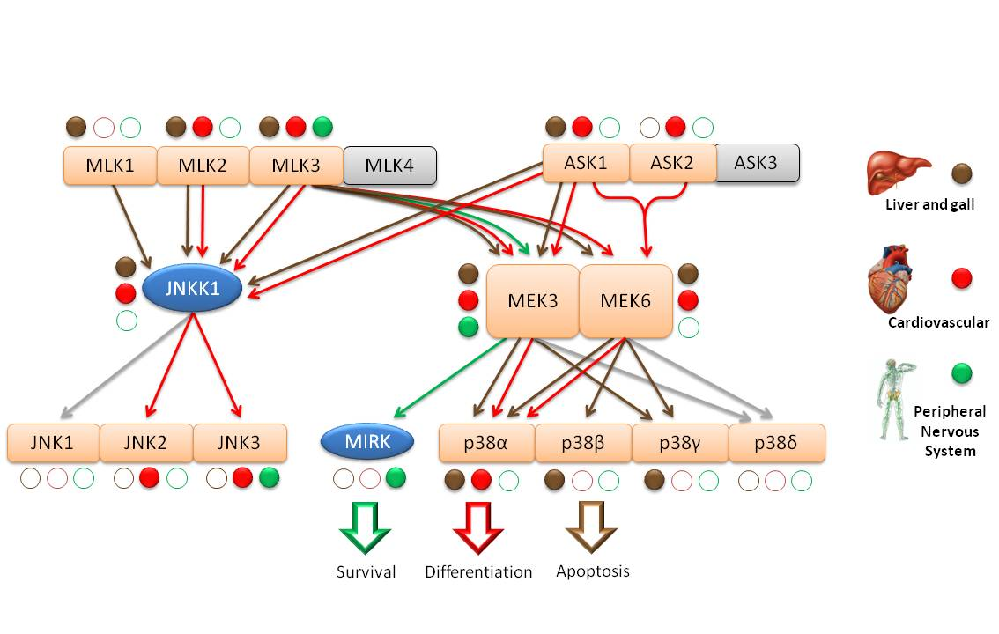
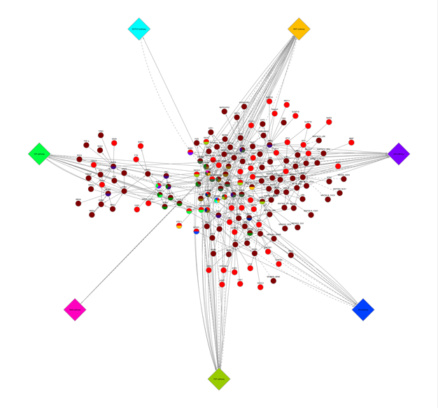
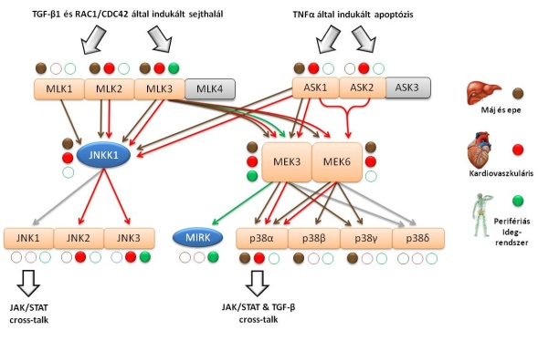
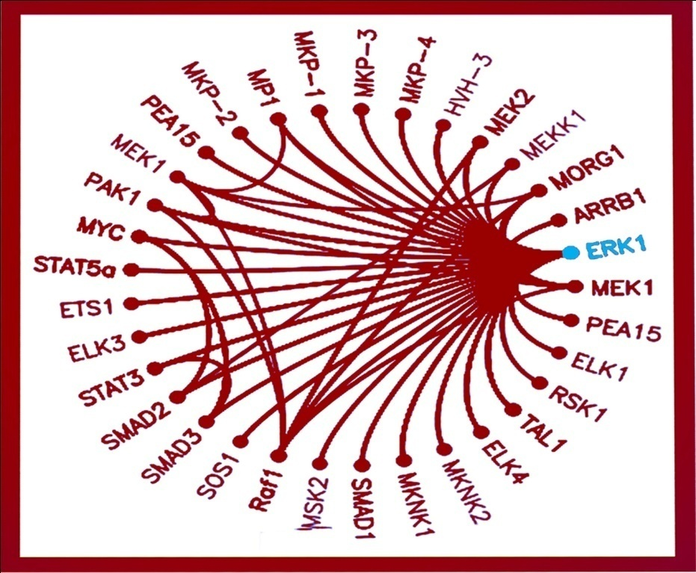
Further cross-talk analyses and visualizations
EGF/MAPK
WNT
NHR
Cross-talk network
TGF
JAK/ STAT
IGF/Insulin
Hedgehog
Average nr. of ortholog proteins or cross-talk
Notch
Cross-talking pathways
Cross-talking proteins

Slide 25
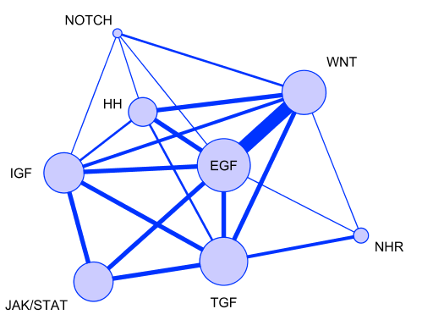
Multi-pathway proteins
Proteins functioning in more than one pathways.
Korcsmaros et al, Bioinformatics (2010)

Slide 26
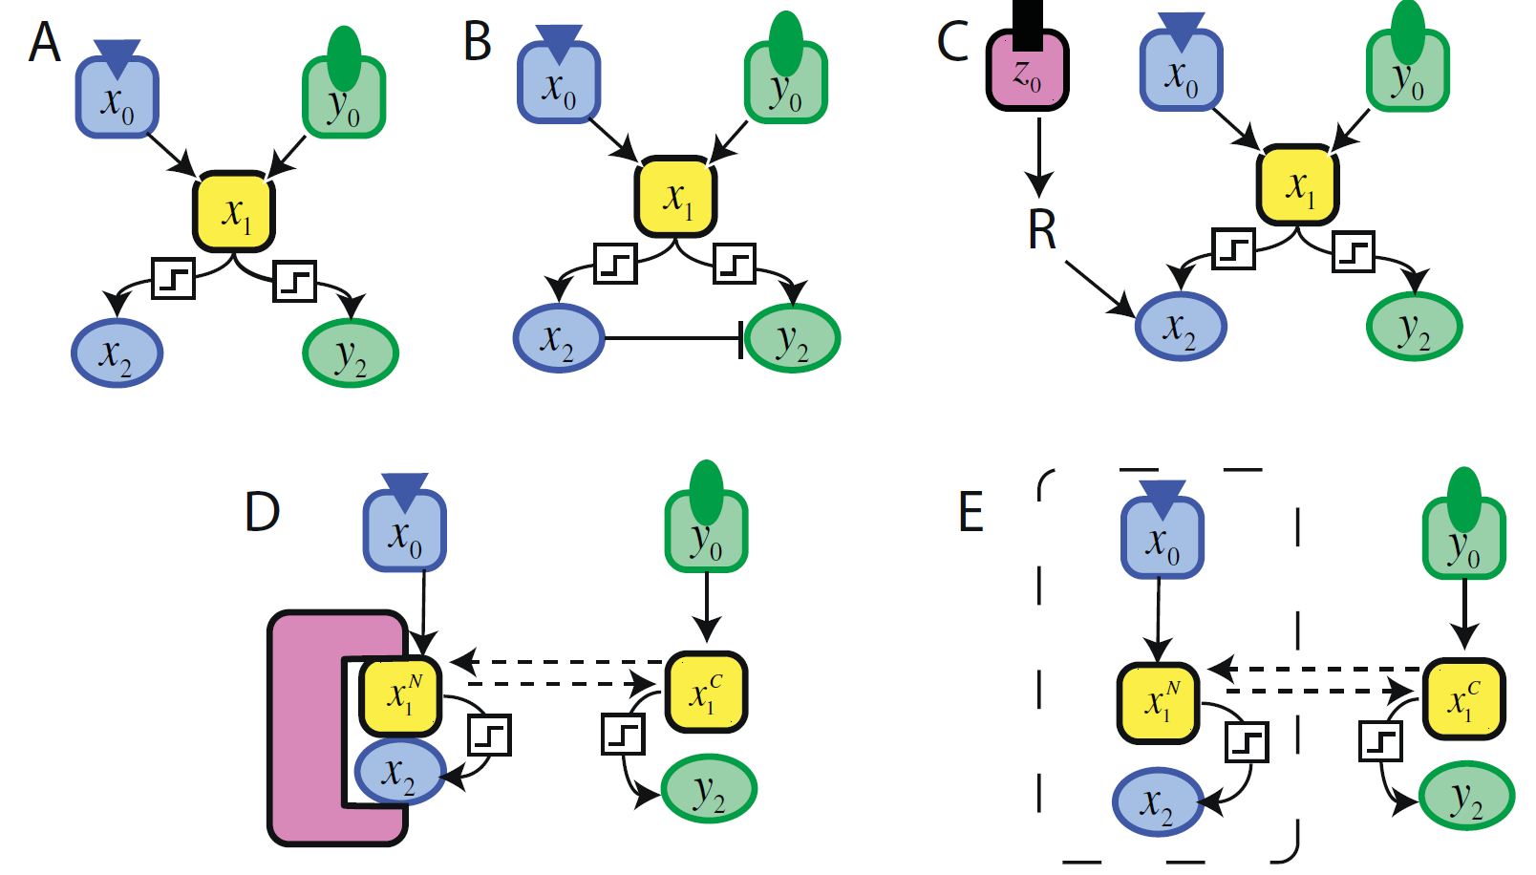
Multi-pathway proteins and the direction of signalling flow
A solution for the contradictions?
Combinatorial problems
Many cell types and phenotypes
But relatively low number of signalling proteins
Relatively low number of signalling pathways
Protein isoforms
Alternative splicing
Post-translational sites
How cross-talks and signalling flow are regulated?

Slide 27
Practical session I.

Slide 28
Data types and identifiers in bioinformatics

Slide 29
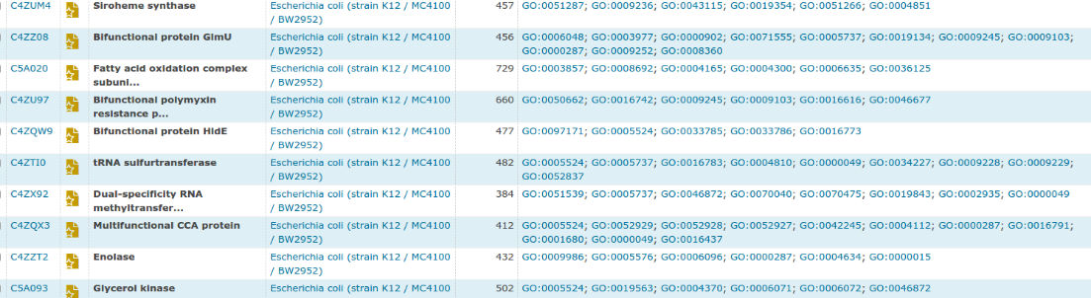
Data types in a text file?
Text Files
Text Files
Text Files
Data sources
Visualisation
Analysis
Integration

Slide 30
Data types
Boolean
Integer
Floating point
Text
List
Matrix
Identifier
Primitive data types
numeric
Composite data types

Slide 31
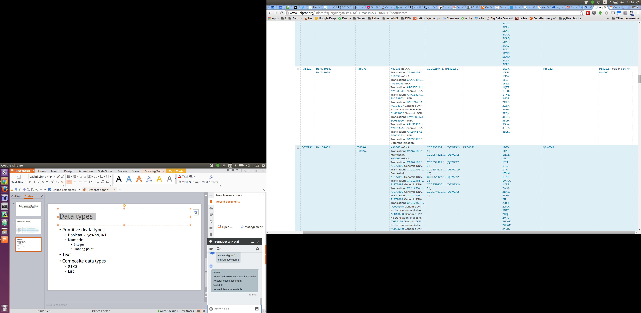
Identifiers
Cross-referencing
Gene/protein name, short name are NOT IDs
Every database has own ID

Slide 32
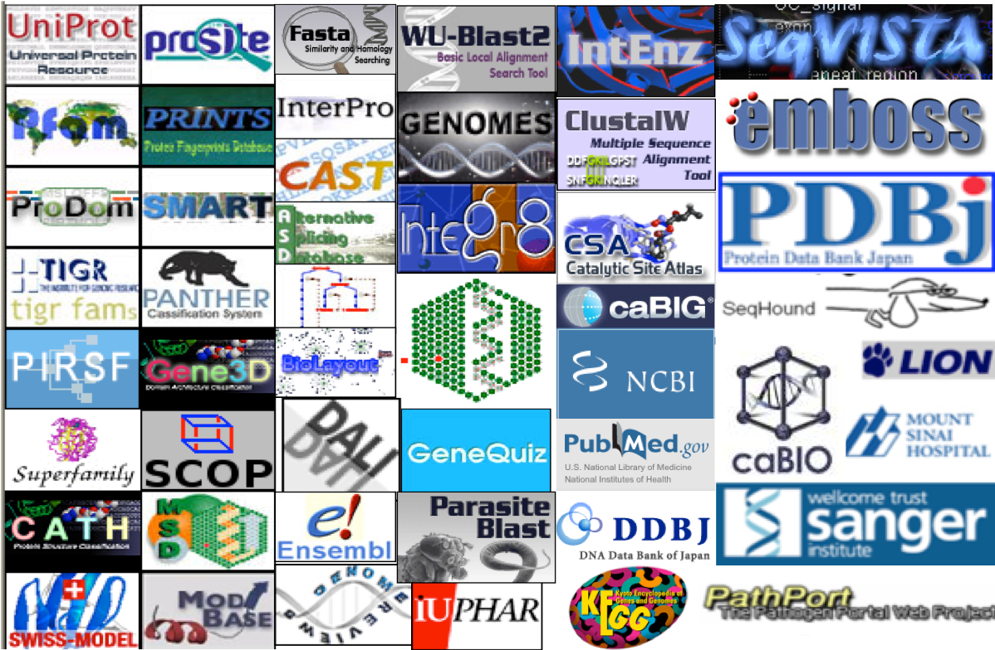
Databases in bioinformatics
Gene DBs
Protein DBs
Domain DBs
3D structure DBs
Expression DBs
Small molecules DBs
PPI DBs
RNA DBs
Taxonomic DBs
Literature DBs
Database DBs
https://en.wikipedia.org/wiki/List_of_biological_databases

Slide 33
Identifier Conversion
Mostly not one-to-one relationship
Mapping
Gene -> Protein
Gene name
Uniprot
P04412
EGFR
P0CY46
P00533
P55245
Q01279
Ensembl
...
ENST00000420316
ENST00000275493
ENST00000342916
ENST00000344576

Slide 34
Practice
Given protein name list (members of the receptor tyrosine kinase pathways from the SignaLink database)
Translate all the protein names to Uniprot IDs
case 1: human proteins
case 2: mouse proteins
Translate all the protein names to Ensembl IDs

Slide 36
Extending cellular signalling pathways taking regulation (transcription factors, miRNAs) and detailed PPIs into account
Tamás Korcsmáros

Slide 37
Multi-pathway proteins and the direction of signalling flow
A solution for the contradictions?
Combinatorial problems
Many cell types and phenotypes
But relatively low number of signalling proteins
Relatively low number of signalling pathways
Protein isoforms
Alternative splicing
Post-translational sites
How cross-talks and signalling flow are regulated?

Slide 38
Insulating mechanisms to regulate signalling flow
Cross-pathway inhibition
Combination of signalling
Scaffolds
Compartmentalization
Haney et al., BMC Systems Biology (2010)

Slide 39
Precise regulation of signalling pathways is important.
Extending signalling pathways to discover regulation processes

Slide 40
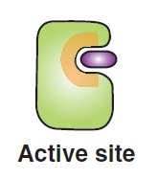
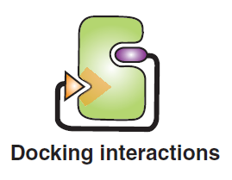
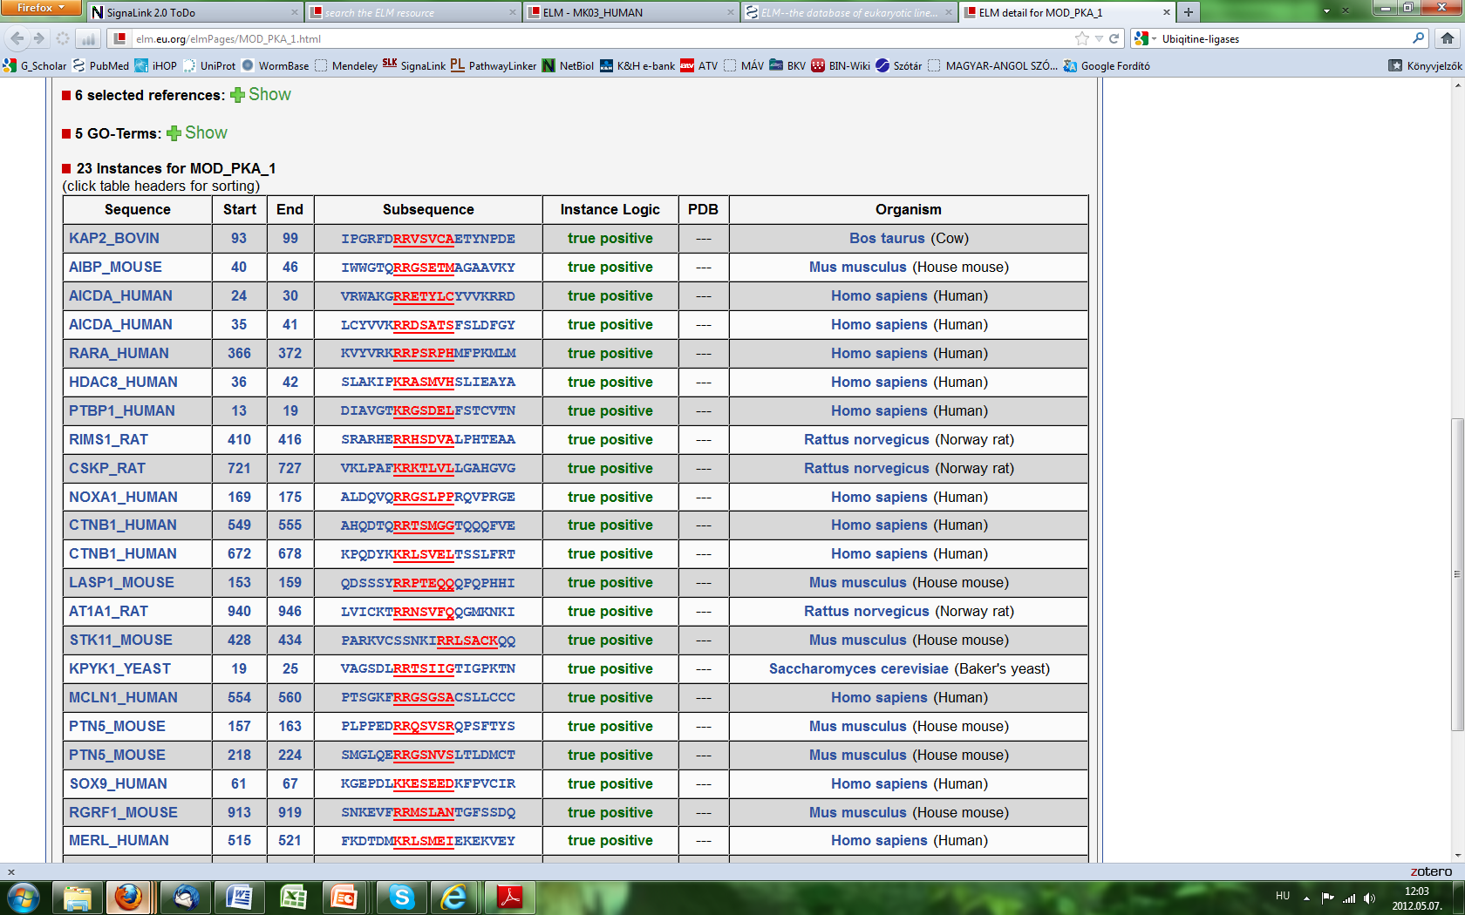
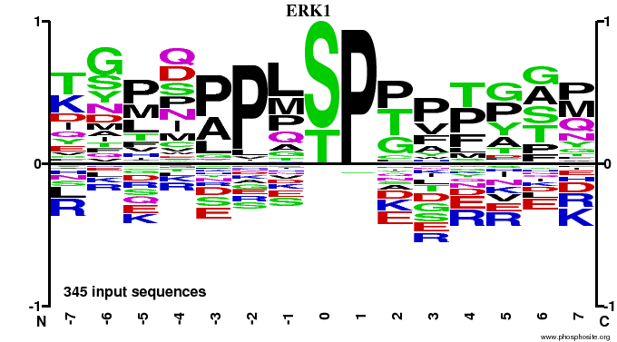
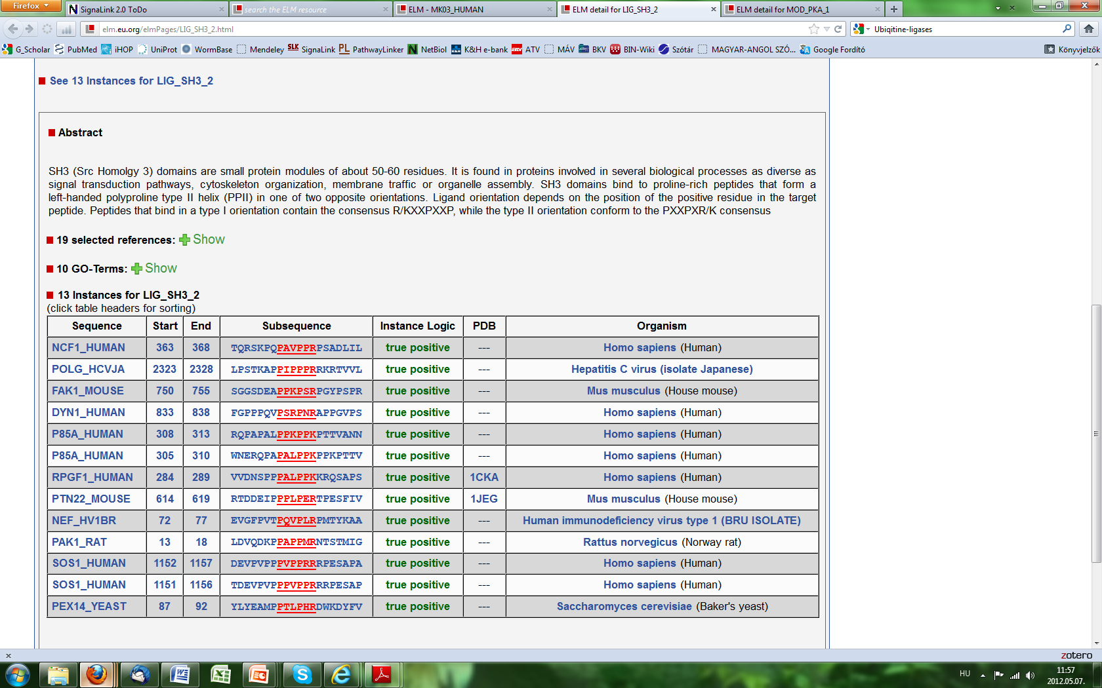
Regulation of signalling duration
Kinases, phosphatases, ubiquitin-ligases, peptidases, etc.
Resources of post-translational modifications (PTMs)
Reversible or irreversible modulation of specific proteins
Priming, activation, temporal de-activation, cleavage, destruction, etc.
NetworKIN (http://networkin.info)
Phosphosite (http://phosphosite.org)
dbPTM (http://dbptm.mbc.nctu.edu.tw)
ELM server (http://elm.eu.org)
…
Specificity?
Target motifs
Docking motifs
P..P.[KR]
Dinkel et al., Nucleic Acids Res. (2012); Bhattacharyya et al., Annu. Rev. Biochem. (2006)

Slide 41
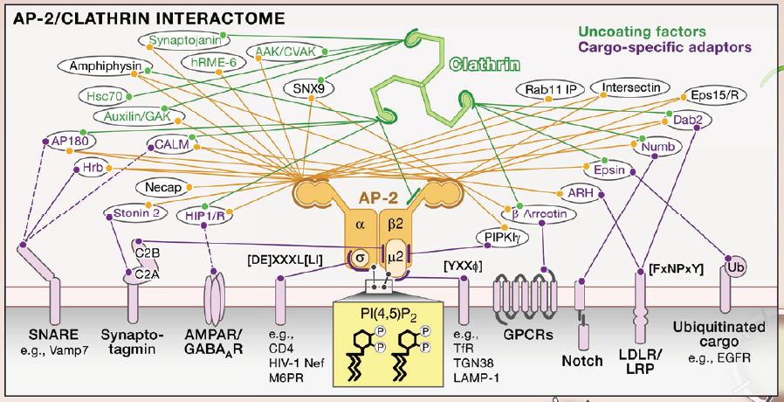
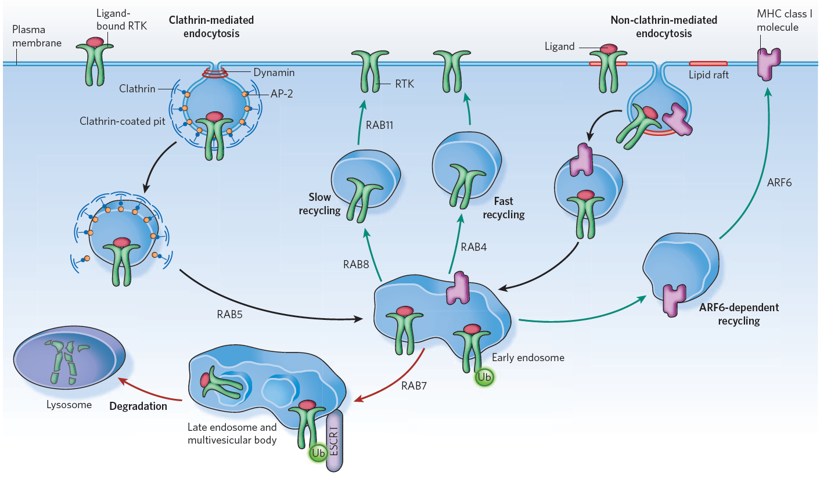
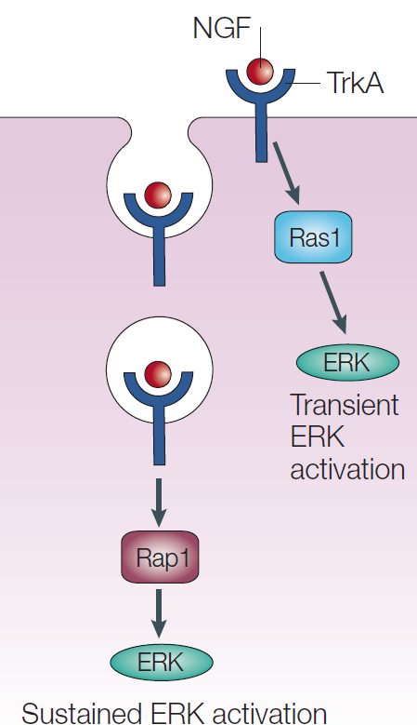
Spatial regulation of signalling by endocytosis
Specific down-regulation, recycling, destruction or signal modulation by general and cargo-specific factors
Scita & Di Fiore, Nature (2010); Wieffer et al., Cell (2009); Gould & Lippincott-Schwartz, Nat.Mol.Cell.Biol (2009)

Slide 42
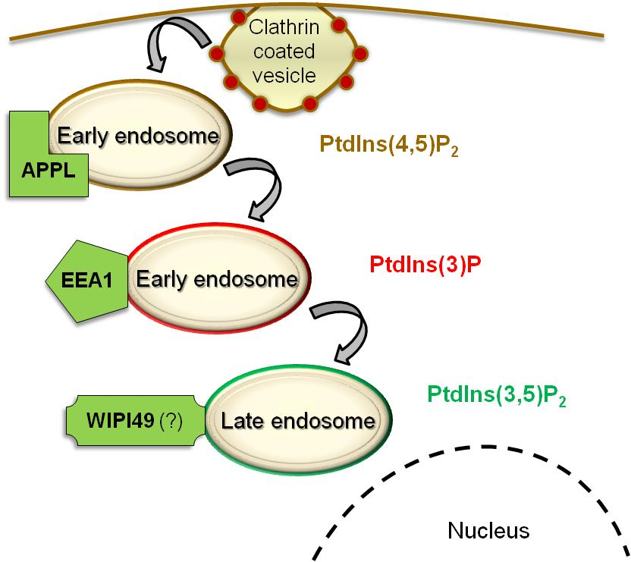
Palfy, Remenyi, Korcsmaros (Trends in Cell Biol, 2012)
An opinion: Cross-talk endosomes
Input 1
Input 2
Cross-talk
X
Y
Scaffold
EL
Endosome
Output 1
Output 2

Slide 43





Regulating the expression of signalling components
Transcriptional regulation
Post-transcriptional regulation
Activation or inhibition of specific gene expression by transcription factor – transcription factor binding site connection
JASPAR (http://jaspar.genereg.net)
TFe (http://cisreg.ca/cgi-bin/tfe/home.pl)
HTRIdb (http://www.lbbc.ibb.unesp.br/htri)
PAZAR (http://pazar.info)
Destruction or inhibition of specific mRNAs by miRNAs
miRBase (http://mirbase.org)
miRGen (http://diana.cslab.ece.ntua.gr/mirgen)
miRecords (http://mirecords.umn.edu/miRecords)
TarBase (http://www.microrna.gr/tarbase)
Specificity?
TF-TFBS target motifs
mRNA-miRNA binding

Slide 44

An important issue: tissue specificity
Human Protein Atlas http://proteinatlas.org
High-resolution images
Spatial distribution of proteins
46 different normal human tissues and 20 different cancer types
47 different human cell lines
Uhlen et al., Nat Biotechnol. (2010), Uhlen et al., Science (2015)

Slide 45
Legends:
Signalling elements
Transcription factors
Cell membrane
Types of networks:
Network of signalling pathways
Nucleus
DNA

Slide 46
Legends:
Signalling elements
Transcription factors
Cell membrane
Types of networks:
Network of signalling pathways
Network of transcription factors
Nucleus
DNA

Slide 47
Legends:
Signalling elements
Transcription factors
Promoters
Cell membrane
Types of networks:
Network of signalling pathways
Network of transcription factors
Nucleus
Network of transcription factors’ binding sites
DNA

Slide 48
Legends:
Signalling elements
Transcription factors
Promoters
Cell membrane
miRNAs
Types of networks:
Network of signalling pathways
Network of transcription factors
Nucleus
Network of transcription factors’ binding sites
Network of promoters and their transcripts
DNA

Slide 49
Legends:
Signalling elements
Transcription factors
Promoters
Cell membrane
miRNAs
Types of networks:
Network of signalling pathways
Network of transcription factors
Nucleus
Network of transcription factors’ binding sites
Network of promoters and their transcripts
Network of miRNAs and transcripts
DNA

Slide 50
Reactome
SignaLink
ConsensusPathDB
…
Component data
Legends:
Signalling elements
wTF2.1
FlyTF
A census of human TFs
Transcription factors
Fantom4
MPromDB
Promoters
miRBase
miROrtho
ABS
TRED
RedFly
EdgeDB
JASPAR
TFe
HTRIdb
ENCODE
miRNAs
Types of networks:
Network of signalling pathways
Network of transcription factors
Interaction data
MPromDB
miRGen
PutMir
TransMir
Network of transcription factors’ binding sites
Network of promoters and their transcripts
miRecords
TarBase
ENCODE
Network of miRNAs and transcripts

Slide 51

Embedding pathways into interaction networks
Trends Biochem Sci, 32: 320–331 (2007)

Slide 52

Protein-protein interactions
Experimentally found interactions
Predicted interactions
Small-scale (precise, can be directed, should be collected)
Large-scale (limited structural details, generally undirected, found in data repositories)
HPRD (http://hprd.org)
BioGRID (http://thebiogrid.org)
IntAct (http://www.ebi.ac.uk/intact)
MINT (http://mint.bio.uniroma2.it)
DroID, WI8, etc.
Homology/orthology-based (interologs)
Domain-motifs based (directed)
Domain-domain based (interaction & direction)
Protein sequence of a protein of interest (eg., from UniProt)
Domain-motif database (eg., ELM server)
Enzymatic domain capable to target the protein
Predicted PPI based on
domain-motif interaction

Slide 53
Protein-protein interactions
Experimentally found interactions
Predicted interactions
Small-scale (precise, can be directed, should be collected)
Large-scale (limited structural details, generally undirected, found in data repositories)
HPRD (http://hprd.org)
BioGRID (http://thebiogrid.org)
IntAct (http://www.ebi.ac.uk/intact)
MINT (http://mint.bio.uniroma2.it)
…
Homology/orthology-based (interologs)
Domain-motifs based (directed)
Domain-domain based (interaction & direction)
Domain-domain interaction data (eg., DOMINE)
Protein-domain composition data (eg., PFAM)
Possible domain pairs
Predicted PPI based on
domain-domain interaction

Slide 54
Protein-protein interactions
Experimentally found interactions
Predicted interactions
Small-scale (precise, can be directed, should be collected)
Large-scale (limited structural details, generally undirected, found in data repositories)
HPRD (http://hprd.org)
BioGRID (http://thebiogrid.org)
IntAct (http://www.ebi.ac.uk/intact)
MINT (http://mint.bio.uniroma2.it)
…
Homology/orthology-based (interologs)
Domain-motifs based (directed)
Domain-domain based (interaction & direction)
Directed PPI from the reference database
(eg., Reactome)
Domain composition as training set
(eg., PFAM)
Liu et al., MCP (2009) and Rhodes et al., Nature Biotechnology (2005)

Slide 55

Protein-protein interactions
Experimentally found interactions
Predicted interactions
Small-scale (precise, can be directed, should be collected)
Large-scale (limited structural details, generally undirected, found in data repositories)
HPRD (http://hprd.org)
BioGRID (http://thebiogrid.org)
IntAct (http://www.ebi.ac.uk/intact)
MINT (http://mint.bio.uniroma2.it)
…
Homology/orthology-based (interologs)
Domain-motifs based (directed)
Domain-domain based (interaction & direction)
Domain composition as training set
(eg., PFAM)
Liu et al., MCP (2009) and Rhodes et al., Nature Biotechnology (2005)

Slide 56

Protein-protein interactions
Experimentally found interactions
Predicted interactions
Small-scale (precise, can be directed, should be collected)
Large-scale (limited structural details, generally undirected, found in data repositories)
HPRD (http://hprd.org)
BioGRID (http://thebiogrid.org)
IntAct (http://www.ebi.ac.uk/intact)
MINT (http://mint.bio.uniroma2.it)
…
Homology/orthology-based (tomorrow)
Domain-motifs based (directed)
Domain-domain based (interaction & direction)
Domain composition as training set
(eg., PFAM)
Liu et al., MCP (2009) and Rhodes et al., Nature Biotechnology (2005)

Slide 57


Case study II. – NRF2 interactome & regulome
Cancer
Ageing
Inflammation
Diseases with oxidative stress
Papp et al. (Korcsmaros), FEBS Letters (2012)

Slide 58

Case study II. – Reconstructing the NRF2 interactome
Similar protocol used for SignaLink but focused only on one protein
BioGRID, HPRD, IntAct, MINT, InnateDB via PathwayCommons
High-confidence, directed interactions based on domain-domain and domain-motif predictions
Papp et al. (Korcsmaros), FEBS Letters (2012)

Slide 59

Case study II. – Reconstructing the NRF2 interactome
Papp et al. (Korcsmaros), FEBS Letters (2012)

Slide 60


Case study II. – Reconstructing the NRF2 regulome
protein expression
protein expression
PPARγ
binding
NRF2
336 fine-tuning regulatory loops
PPARγ
NRF2
NRF2
PPARγ
34 TFs
3 regulatory loops
164 TFs
Transcriptional regulation
JASPAR
Regulation of 63 miRNAs
85 miRNAs
Post-transcriptional regulation
NRF2
Transcriptional regulation
7,469 targets
PutMir,
TransMir
JASPAR
MirBase
Papp et al. (Korcsmaros), FEBS Letters (2012)

Slide 61
Case study II. – Reconstructing an integrated NRF2 network
336 fine-tuning regulatory loops
34 TFs
3 regulatory loops
164 TFs
Transcriptional regulation
Regulation of 63 miRNAs
85 miRNAs
Post-transcriptional regulation
NRF2
Transcriptional regulation
7,469 targets
Post-translational regulation & interactions
39 regulatory loops
224 proteins
phosphorylation
JNK1
NRF2
ELM, dbPTM, experimental PPIs
protein expression
NRF2
Papp et al. (Korcsmaros), FEBS Letters (2012)
JNK1

Slide 62
Reactome
SignaLink
ConsensusPathDB
…
Component data
Legends:
Signalling elements
wTF2.1
FlyTF
A census of human TFs
Transcription factors
Fantom4
MPromDB
Promoters
miRBase
miROrtho
ABS
TRED
RedFly
EdgeDB
JASPAR
TFe
HTRIdb
ENCODE
miRNAs
Types of networks:
Network of signalling pathways
Network of transcription factors
Interaction data
MPromDB
miRGen
PutMir
TransMir
Network of transcription factors’ binding sites
Network of promoters and their transcripts
miRecords
TarBase
ENCODE
Network of miRNAs and transcripts

Slide 63

SignaLink 2.0 A signalling pathway resource with a multi-layered regulatory network
Fazekas et al BMC Syst Biol, 2013

Slide 64


Slide 65


Slide 66


Slide 67


Slide 68


Slide 69


Slide 70


Slide 71


Slide 73
SignaLink 3 – coming soon
Zebrafish
More interaction details
Extended coverage
Linkouts from UniProt, Wormbase, Flybase
http://SignaLink.org

Slide 74
Practical session II.

